Slide 1
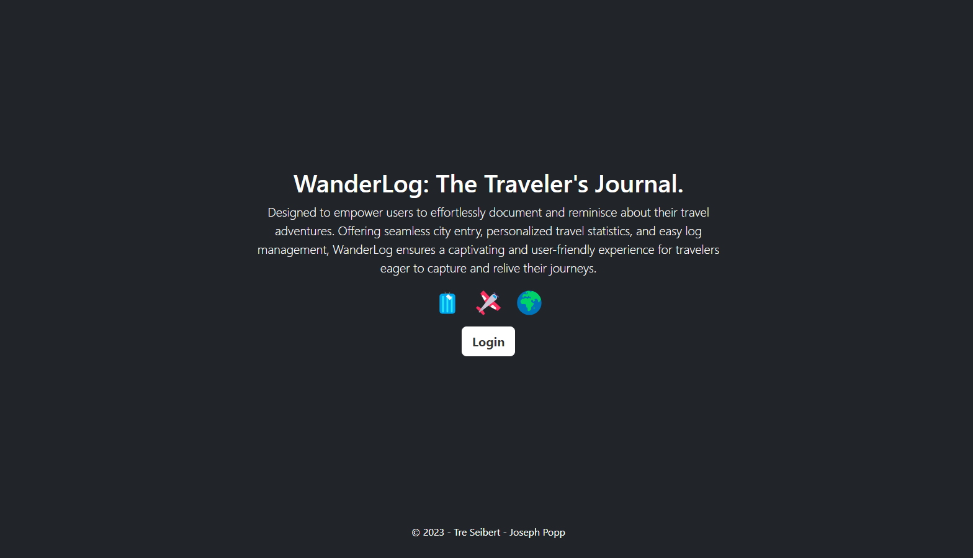

Slide 2
Landing Page
Greets user and talks a little bit about WanderLog
Login button, redirects to /login.html

Slide 3
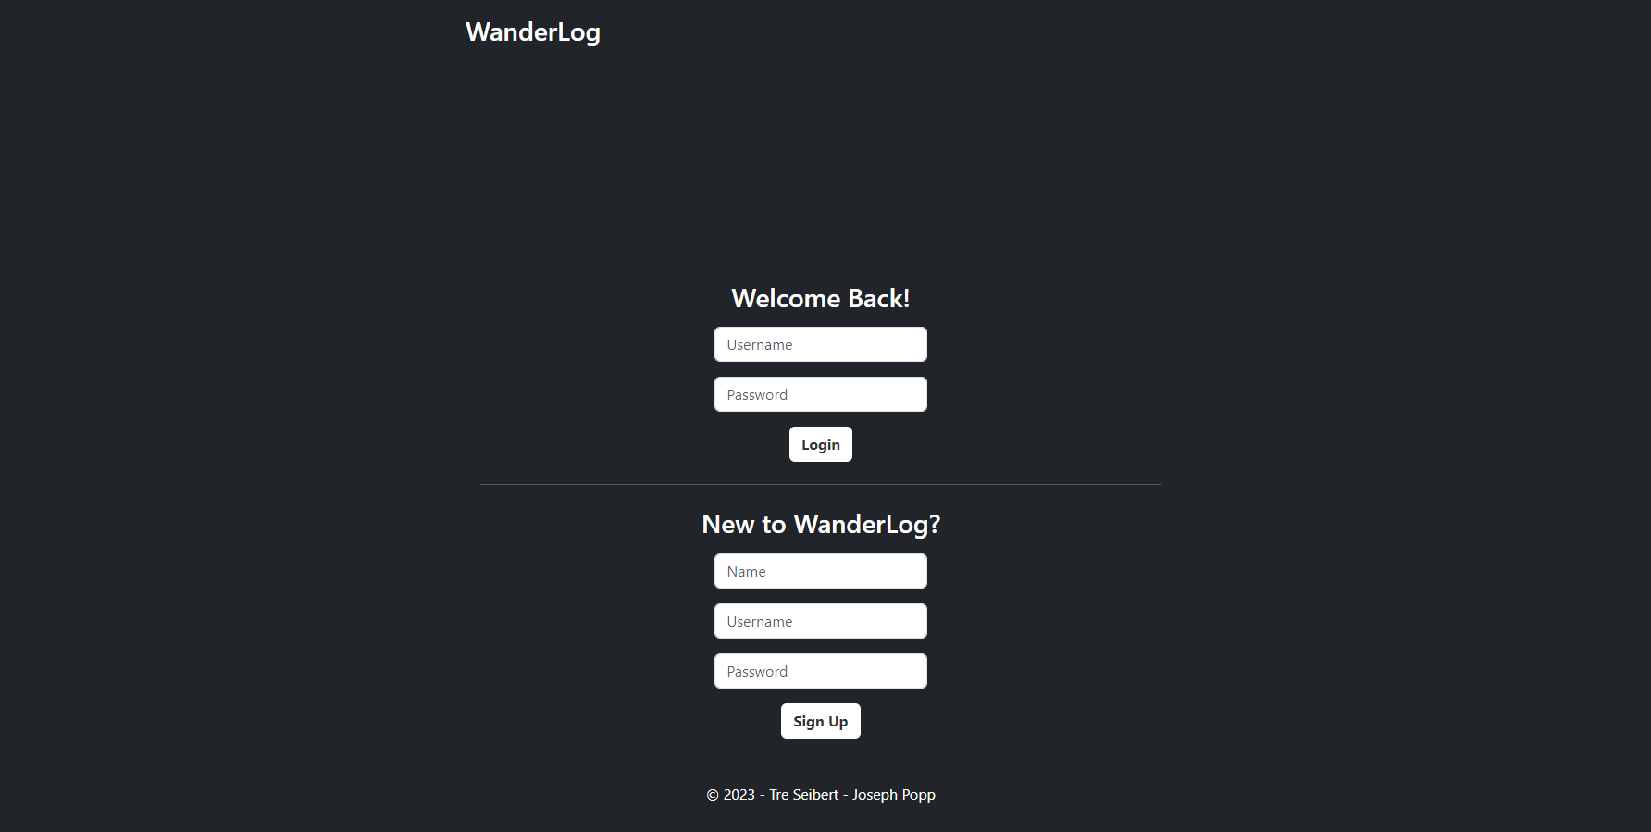

Slide 4
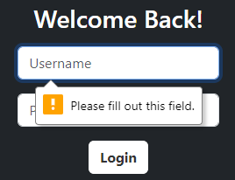
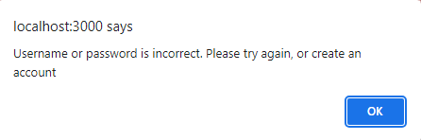
/login.html
Login fields
Accepts username and password as inputs
Checks for matching values in SQL users table
Redirects to /home.html if match is found
Assigns global “username” variable using cookies
Restrictions used to prevent users without passwords access information
Session tracking to ensure data integrity
Client Side Error handling when no username/password combination match is found, or field is left empty:

Slide 5
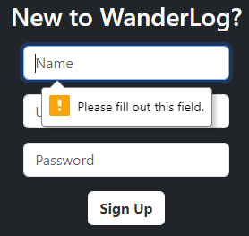
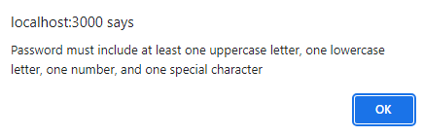
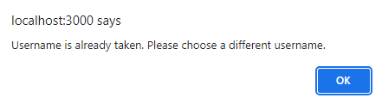
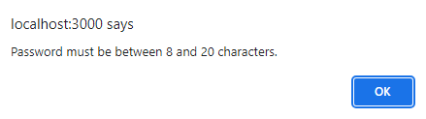
/login.html
Sign up fields
Name, username, and password are input fields
Creates new tuple with inputted information
Username set as primary key
Password is encrypted using bcrypt node js library
Redirects to /home.html if inputs are valid
Assigns global “username” variable using cookies
Client Side Error Handling when username is not available, username or password is invalid, or field is left empty: password must be between 8 and 20 characters, and must include at least one uppercase letter, one lowercase letter, one number and a special character.

Slide 6
/login.html
Page title is a home button
Directs back to landing page

Slide 7
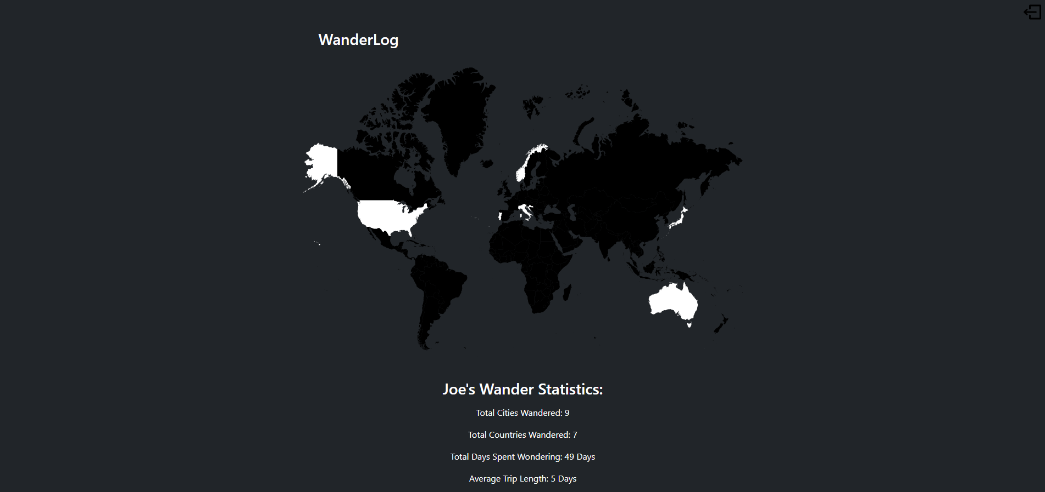


Slide 8
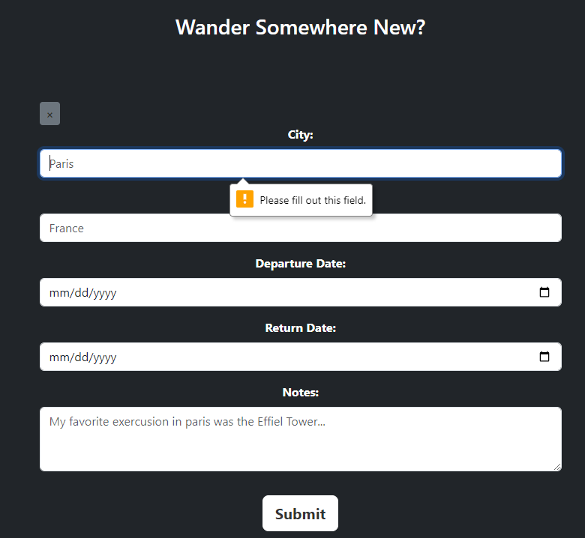
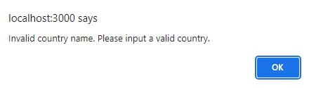
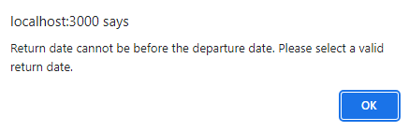
/home.html
Add new visited city and country
Toggleable form
City, country, departure date, return date, notes are input fields
Creates new tuple in visits table with inputted information
Username taken from global variable
Submits a post request to /post if inputs are valid
Error checking when inputted invalid country, invalid
date order, or field is left empty:

Slide 9
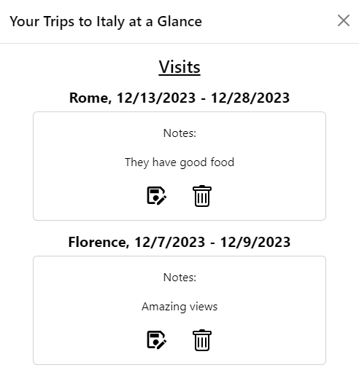
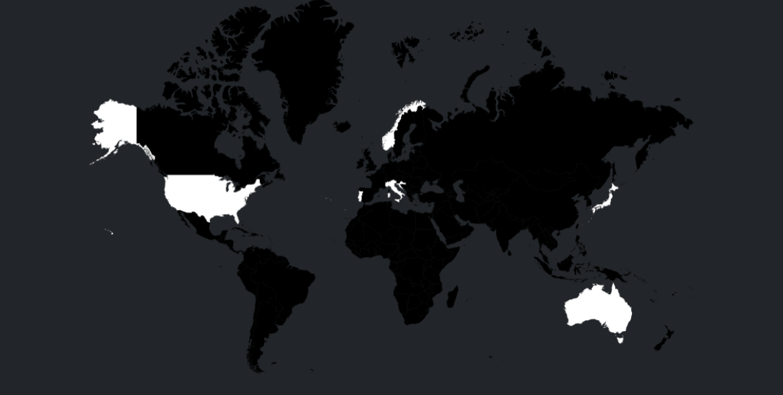
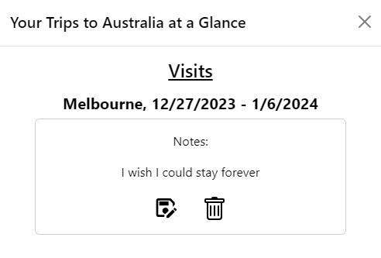
/home.html
Interactive map
Searches SQL visits table for user’s visits using global username variable
A users visited countries turn white for easy visualization
Clicking on a white/visited country opens bootstrap modal:

Slide 10
/home.html
Bootstrap modal
lists user’s information from each visit in selected country using global username
Edit/save button to update notes for any given trip
Replaces paragraph element to a textfield element for user input
Saves input to the database after altering content in textfield and returns back to paragraph element
Delete button
Deletes respective visit from the database
Refreshes page

Slide 11
/home.html
User Statistics
Displays user’s “name” from SQL users table
Displays information based on user’s visits in SQL visits table
Total cities, total countries, total days traveling, average trip length
Calculates values using SQL queries

Slide 12
/home.html
Logout button
Eliminates username global variable
Eliminates a users session cookie, effectively destroying their session
Uses POST request to /login route using express-session node js library
Deletes cookie from session
Redirects user to /login.html

Slide 13
Misc.
Session tracking
Done by node js express-session library and crypto library
Crypto library used to generate session secret key
Session expires after 30 seconds of inactivity
User is logged out
Responsiveness
WanderLog is 100% responsive and looks great on any device using bootstrap

